Slide 1

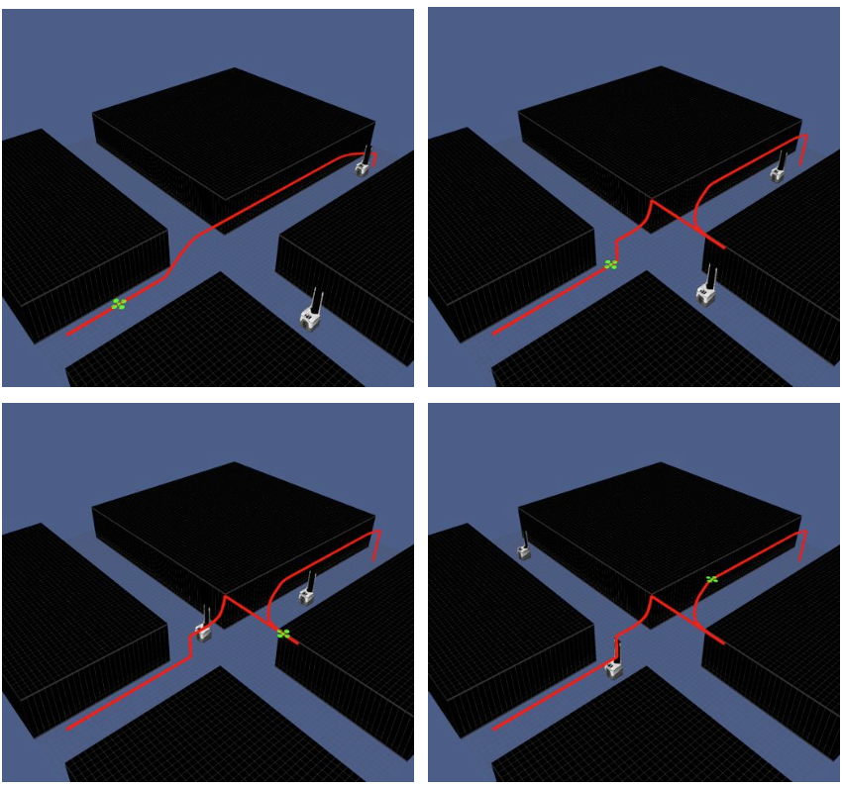
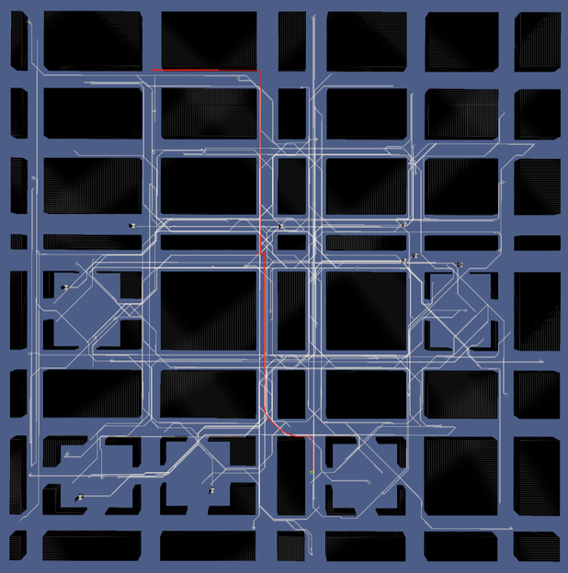

Path Planning and 3D virtualization
Group 4

Slide 2
Outline
Article and Idea
The Implementation
Path Planning ( cr ruofanz, herany )
3D virtualization( cr gauthamn, Mbhat, rchavali)

Slide 3
The Article and Idea

Slide 4
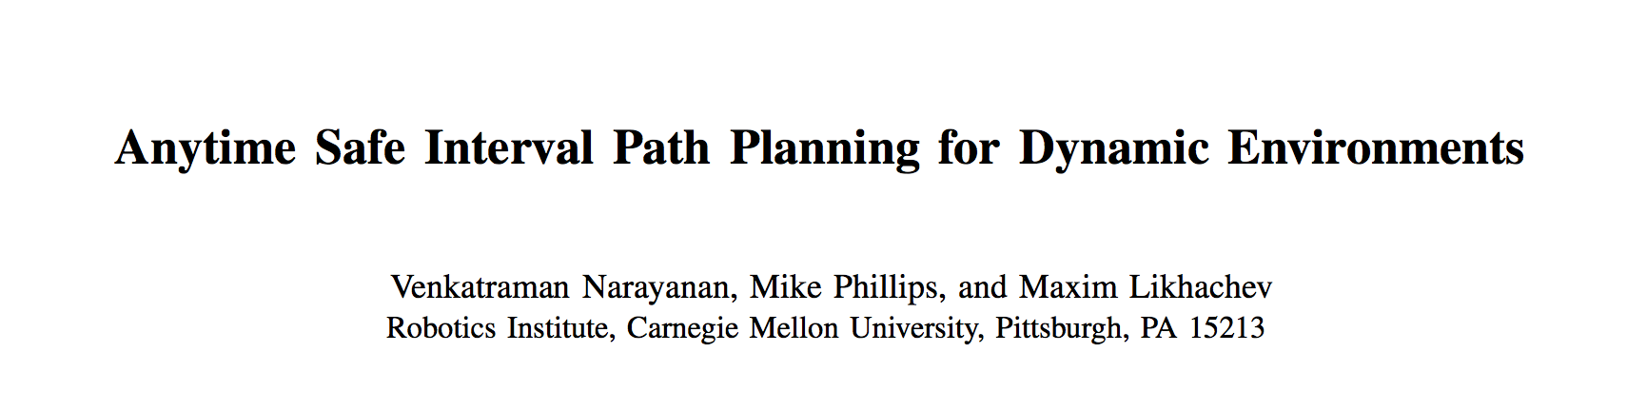
Path Planning in dynamic environments under time constraints.
A*-variant algorithm for planning using intervals
optional time-horizon
simulation experiments

Slide 5
Idea
Path-planning
1.simulation in closed scenario in a factory model.
2. Many small robots pick and drop boxes automatically without collision and deadlock with each other.
3D-virtualization
A 3D visualizer using OpenGL to conceptualize a path planning algorithm.
The idea is to have a path planning algorithm such as A-Star and its modified versions running in the back- end while the visualizer forms the front end of the project.

Slide 6
The Implementation
1. Path Planning
2.3D virtualization

Slide 7
First Part : Path Planning
Module
Collaboration of Different Part
Result

Slide 8
Task Schuduling
Path
Planning
for
Veticles
Emulator
Short
Path
Grant
Module
Map
Path Planning Modules

Slide 9
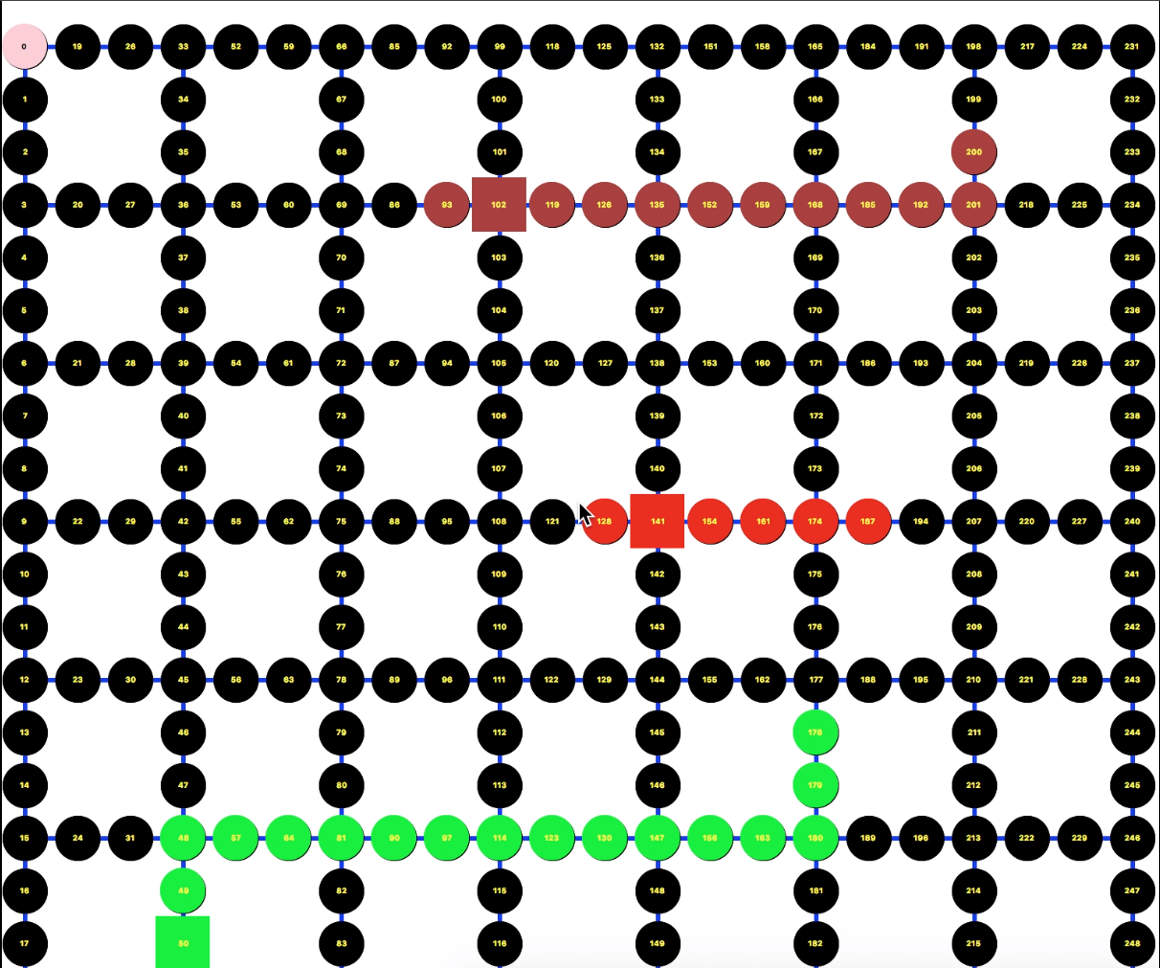
Map
The Map consist of Links and Nodes, which is very similar to the “Graph Data Structure”. And each node has it’s linked-node which I call neighbour_node in our code. Each Link is a two way link.

Slide 10
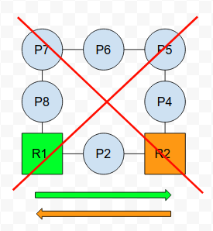
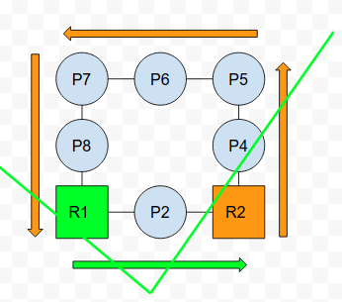
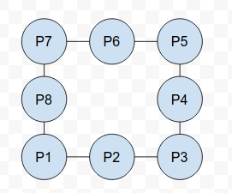
Path Planning Algorithm
The path planning Algorithm is based on A-Star (like problem set 8), but very different. Since the map’s Links are all double-way, which means if “a” can go to “b”, “b” also can go to “c”. The hard part is if we only use the A-Star algorithm, if Robot_1 want to go from “p1” to “p3”, the shortest path is “p1→p2→p3”, if Robot_2 want to go from “p3” to “p1”, the shortest path will be “p3→p2→p1”, then they will collide with each other. So to solve this problem we use the safety_time_intervals, each node have it’s safety_time_intervals, the algorithm is very complex to say, but shortly speaking, it is a barrier (just like the A-Star barrier), but the barrier will exists in some period and in other period they will be gone. So finally the path will look like Robot_1:”p1→p2→p3”, Robot_2:”p3→p4→p5→p6→p7→p8→p1”, something like that.

Slide 11
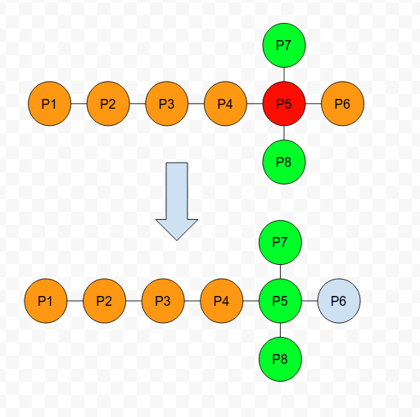
Short Path Grant Algorithm
This part is my own idea, because in the real-scenario, maybe the Robot speed is not constant, maybe some fluctuations or maybe some malfunctions for seconds. So it will break the original time-window, for example we want Robot_1 to go like “p1→p2→p3→p4→p5→p6”, Robot_2 go like “p7→p5→p8”, travel time of each link is 1 second for example, In this situation, if they go just like what I expect it to go, there will not be any collide, but if somehow the Robot_2 has some issue and stop at p5 for 10 seconds, then the two robots will be collide with each other, not good! So I think of this idea so that every time I assign a short path to them and each of the short path has no collisions at all. And the short path is extended and squeezed when the Robots are moving

Slide 12
Simulator && Deadlock Checker
Very Simple, Just let the car move 1 node per second due to their short path.
If three Robots do not move for a long time, it must be some errors, so Let the Path_Planning module recalculate the path.

Slide 13
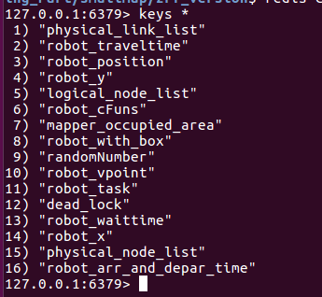
Modules Collaboration
We use Redis as shared-memory, so every module can use the same data.

Slide 14
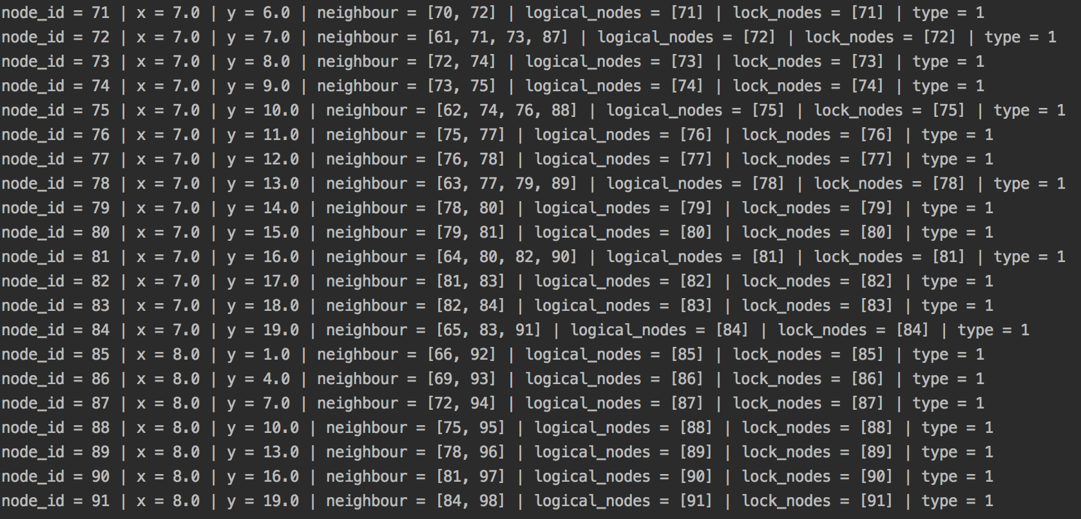
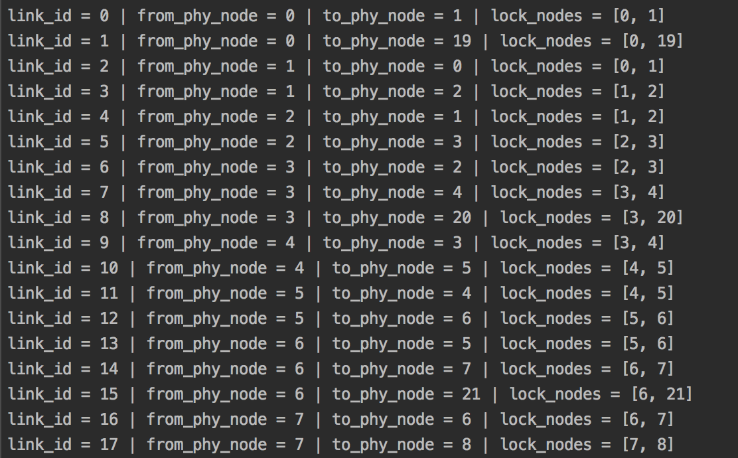
Result and Customization
smaller map

Slide 15
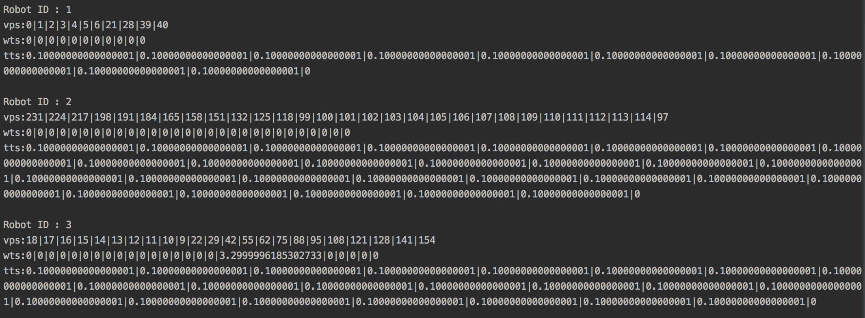
Result and Customization
2. Path planning module

Slide 16
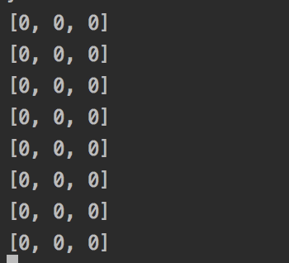
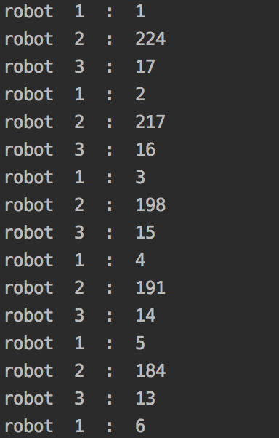
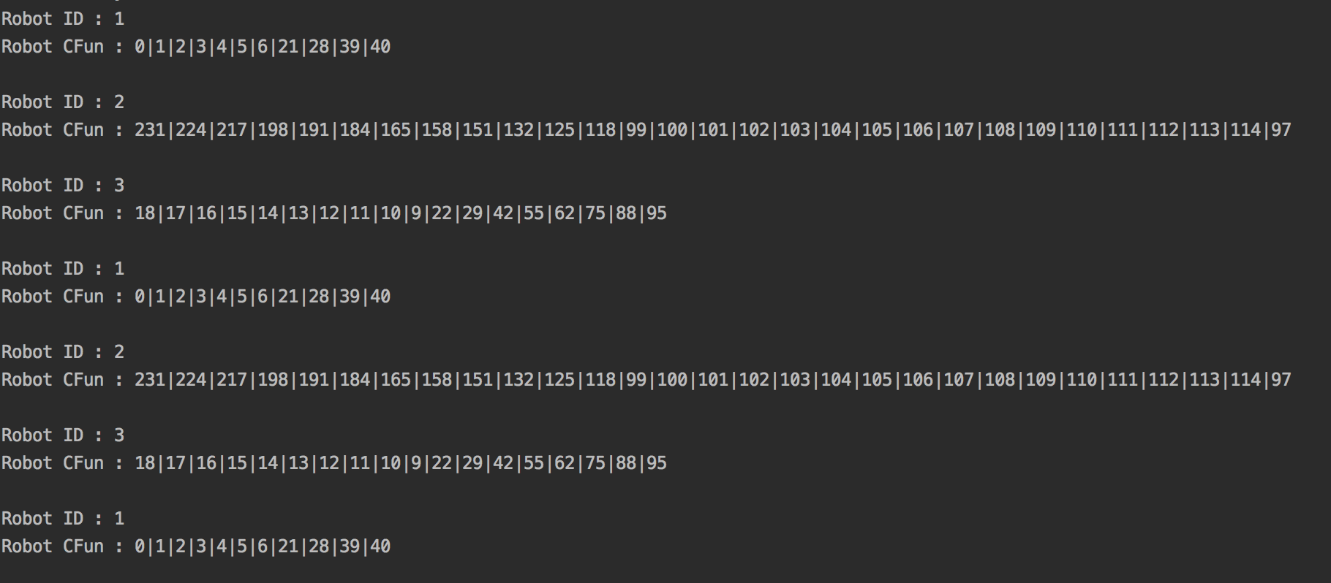
Result and Customization
3 Deadlock Checker Emulator Short Path Grant Module

Slide 17
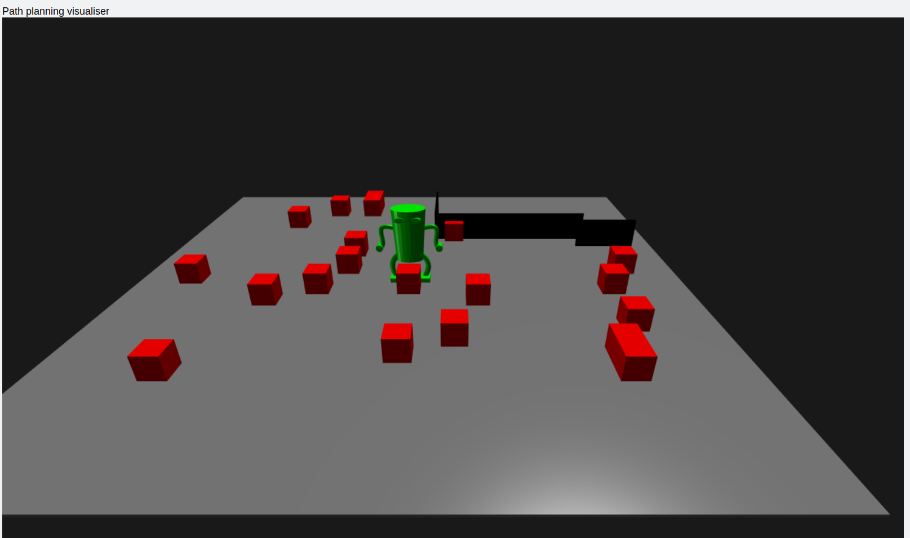
3D Path Planning visualiser in OpenGL – with obstacles

Slide 18
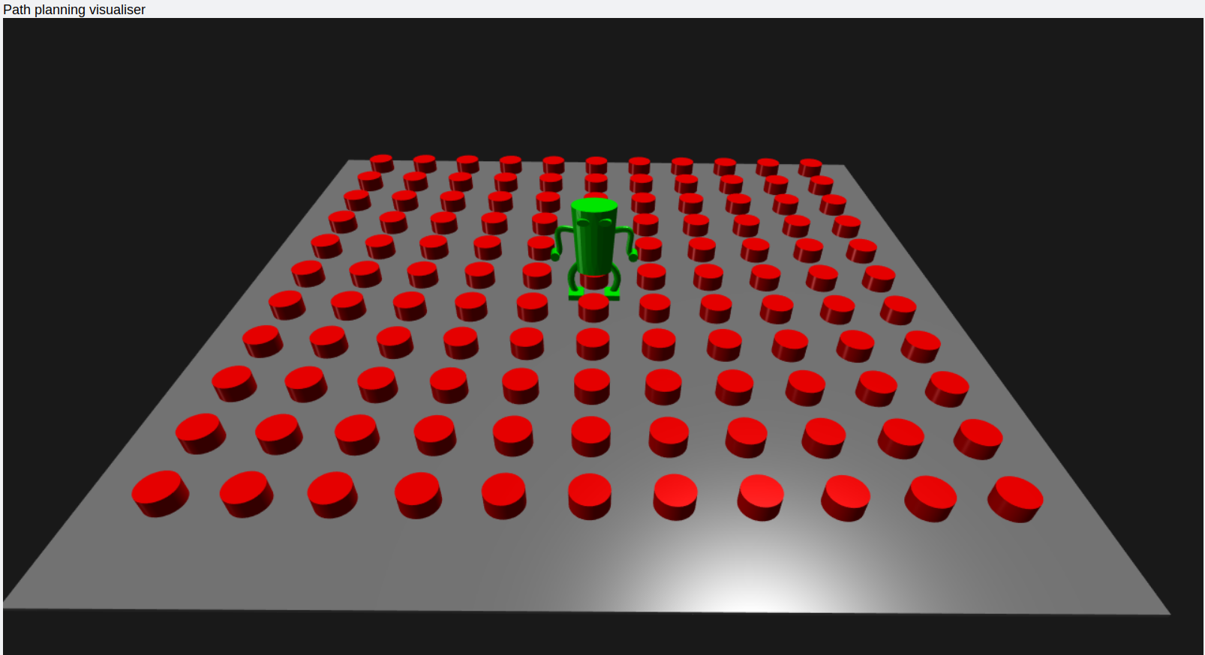
3D Path Planning visualiser in OpenGL – grid

Slide 19
Result and Customization
4. GUI SIMULATOR

Slide 20
Questions?

